Slide 1
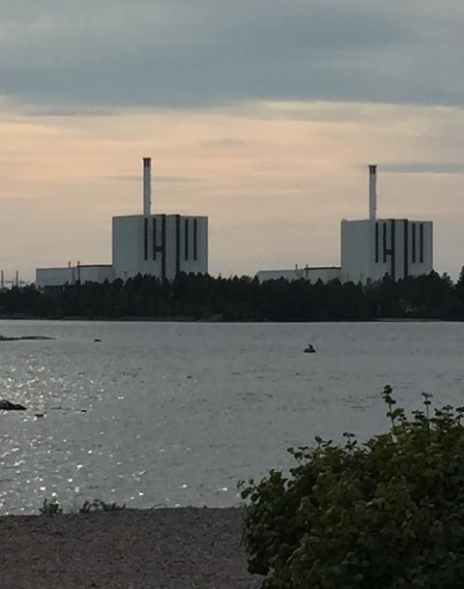
Vibrations in nuclear applications
Vision: Reduce production losses caused by vibration related problems
R&D and practical information exchange
Time frame 2019-2021
Program volume 1 MSEK/year
Focus areas:
Digitalized vibration management
Technical challenges
Implementation and knowledge transfer
Results
Reports can be downloaded from www.energiforsk.se
Seminars
Tools/guidelines
Notes:
TVO are stakeholders in Vibrations
Photo: O3 generator rotor

Slide 2
Stakeholders Energiforsk Vibrations:

Slide 3
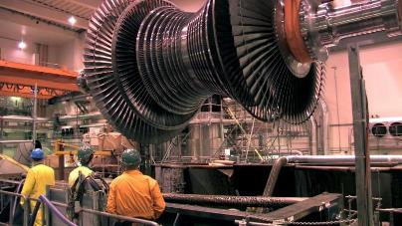
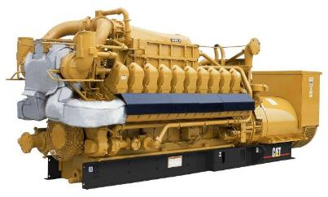
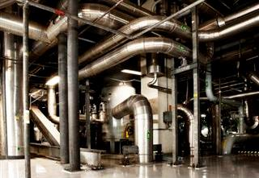
WHY a program on vibrations?
Challenges
Knowledge among partners
Lack of requirements/standards
Load follow
Exchange of components
The program facilitates
Knowledge increase
Knowledge transfer
Collaboration

Slide 4
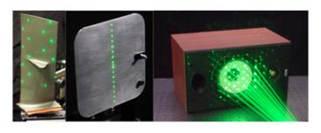
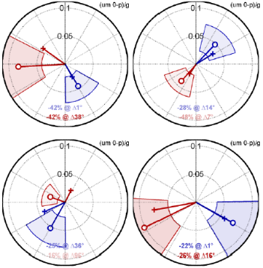
Ongoing activities
Survey of optical methods for vibration response measurements, Juha Virtanen, VTT
Mapping of dampers
Influence coefficients for balancing, Rainer Nordmann
Notes:
TVO are stakeholders in Vibrations
Photo: O3 generator rotor

Slide 5
Finalized activities
Nordic Nuclear Power Generator Stator Vibrations, Gabor Csaba and Kent Engvall, Fortum TGS
Mitigation of Diesel Generator Vibrations in Nuclear Applications, Antti Kangasperko
Vibrations caused by load follow, Rainer Nordmann & Christopher Ranisch, Fraunhofer Institute
Turbine and generator vibration - analysis and mitigation, Rainer Nordmann
Pipe vibrations investigation - analysis and mitigation, Mikko Merikoski, FS Dynamics
Torsional vibrations in shaft trains, Harald Breitbach, Wölfel Engineering
Pipe vibrations measurement, Magnus Källman ÅF
Thesis works CFD calculations on FIV data
FIV experiment neutron detection housing pre-study + study, Vattenfall R&D
Rotor dynamical analysis of pumps, Lloyd's Register

Slide 6
Documentation finalized activities
Project | Documentation
KKU51431 Mapping of stator vibrations, Gabor Csaba and Kent Engvall, Fortum TGS | 2019:621 Nordic Nuclear Power Generator Stator Vibrations
KK51432 Seminar Vibrations in nuclear applications, November 13, 2018 | Documentation
KK51430 Presentation of standards regarding balancing and vibrations/machinery | Reported at seminar on November 13, 2018.
KK51428 Workshop tuning of parameters in pipe DIAM matrices, Kjell-Olof Björk and Mikko Merikoski, FS Dynamics | Updated matrices can be obtained from Monika Adsten.
KK51427 Thesis work on diesel vibrations, Magnus Ohlson, FS Dynamics. Thesis worker Antti Kangasperko. | 2018:544 Mitigation of Diesel Generator Vibrations in Nuclear Applications
KK51425 Vibrations caused by load follow, Rainer Nordmann & Christopher Ranisch, Fraunhofer Institute | 2018:521 Vibrations Caused by Load-follow in NPPs
KK51424 Seminar Vibrations in nuclear applications November 8, 2017 | Documentation
KK51423 Extension of the turbine and generator vibration mapping project, Rainer Nordmann | 2017:440 DIAM – A Matrix Tool for Turbine and Generator Vibrations
KK51422 Torsional vibrations in shaft trains, Harald Breitbach, Wölfel Engineering | 2018:522 Torsional Vibrations in Steam Turbine Shaft Trains
KK51421 Seminar Vibrations in nuclear applications Oct. 4 2016 | Documentation
KK51420 Extension of pipe vibrations investigation - analysis and mitigation, Mikko Merikoski, FS Dynamics | 2017:451 Pipe Vibrations in Nuclear Applications
KK50427 Pipe vibrations measurement, Magnus Källman ÅF | 2017:351 Pipe vibrations - measurements
KK50426 Turbine and Generator Vibrations – Analysis and Mitigation, Rainer Nordmann | 2016:295 Torsional and stator vibrations in turbines and generators 2016:294 Lateral Turbine and Generator Vibrations
KK50424 Thesis works CFD calculations on FIV data | 2016:269 HPC FSI simulation of a rod subjected to axial turbulent flow 2016:238 Fluid Structure interaction analysis on vibrations of a rod exposed to axial flow
KK50421 FIV experiment neutron detection housing pre-study + study, Vattenfall R&D | 2015:160 Fluid induced vibrations in neutron detection housing
KK50420 Rotor dynamical analysis of pumps, Lloyd's Register | 2015:117 Rotordynamic study of pumps in the nuclear industry

