Slide 1
Energiforsk Project: Lectures in the Power Plants
Ringhals, Oskarshamn and Forsmark, March 2024
Annual Energiforsk Seminar (10.11.21)
Vorlesungen Mechatronik im Wintersemester
Vibrations of Turbines and Generators in Power Plants
Lecture II The Subsynchronous Resonance Phenomenon (SSR)
Rainer Nordmann
Technische Universität Darmstadt

Slide 2
Lecture I The Sub Synchronous Resonance Penomenon (SSR)
Definition of Sub Synchronous Resonance (SSR)
Excitation of Vibrations in Turbogenerators due to Air Gap Torques
Conditions for Torsional Vibrations with Sub Synchronous Resonance
A simple Electrical Model with Series Compensation
Electrical Natural Frequencies and Impedance Functions
An SSR- Incident in the OL3 Turbogenerator

Slide 3
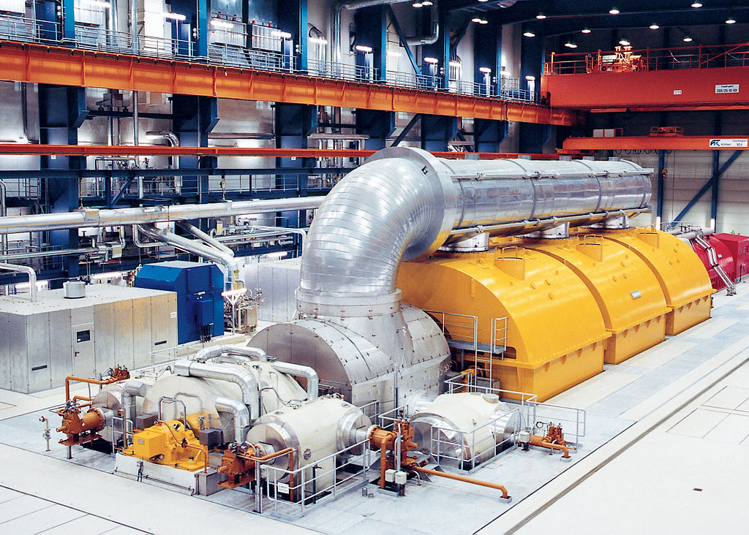
Definition of Sub Synchronous Resonance (SSR)
Turbogenerator System with Mechanical Components
Generator
Pipe
System
Low Pressure
Turbines LPT
High Pressure
Turbine HPT
Turbogenerator System with Mechanical Components

Slide 4
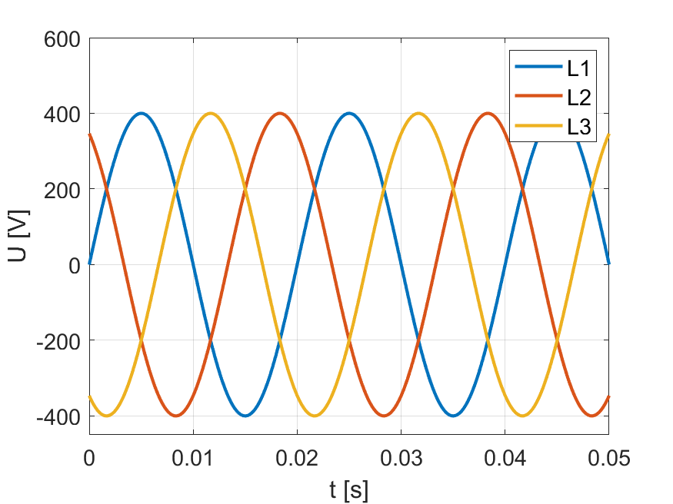
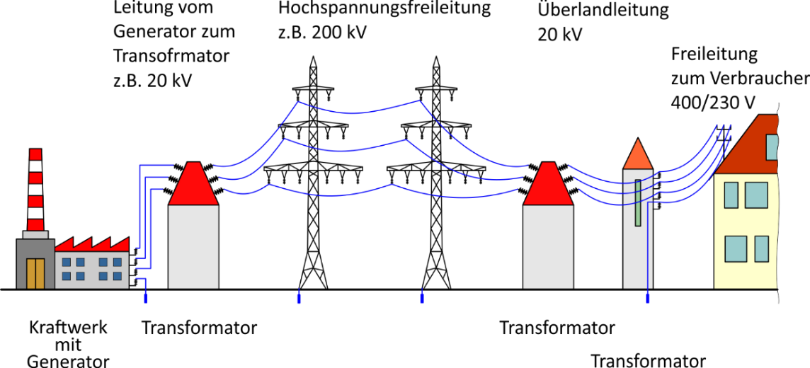
Definition of Sub Synchronous Resonance (SSR)
Turbogenerator System and the Electrical Grid System
The Turbogenerator System with Mechanical and Electrical Components
and the Electrical Grid System

Slide 5
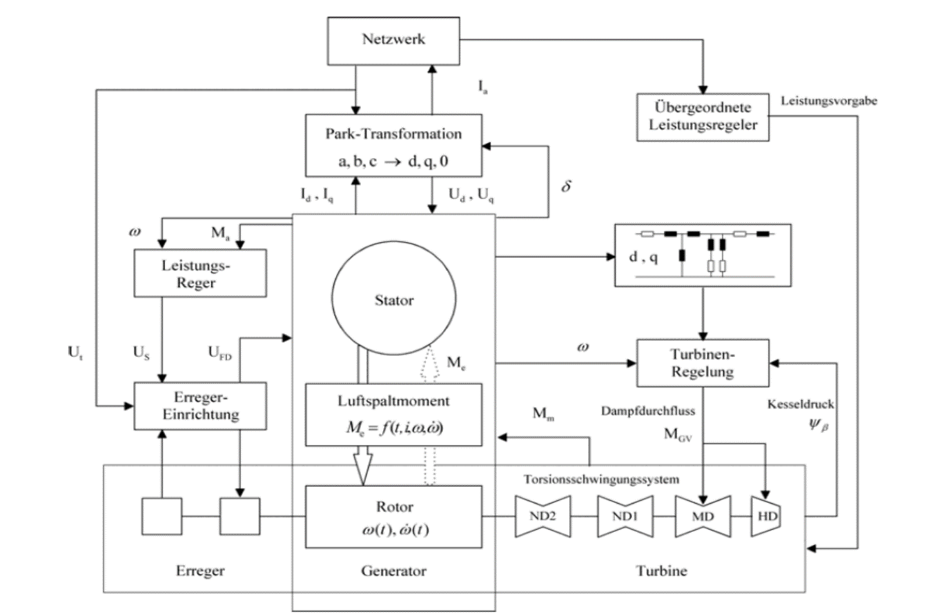
Definition of Sub Synchronous Resonance (SSR)
Block-Diagram: Turbogenerator System and Electrical Grid System
Electrical Grid
Electrical
Components of
Turbogenerator
Mechanical
Components of
Turbogenerator

Slide 6
Definition of Sub Synchronous Resonance (SSR)
Modelling of the Turbogenerator System and the Electrical Grid System
Electrical Grid
Electrical
Components of
Turbogenerator
Mechanical
Components of
Turbogenerator

Slide 7
Definition of Sub Synchronous Resonance (SSR)
Energy Exchange between the Mechanical and the Electrical System
Subsynchronous Resonances are oscillations in the electrical and mechanical systems, which can occur when turbine generator units feed into a network,the long lines of which are compensated by series capacitors.
Triggered by a fault in the electrical system, representing an electrical resonant circuit, there is an exchange of energy between the mechanical shaft and the inductive and capacitive elements of the electrical „generator, transformer, line, network“ circuit .
The resulting currents generate low frequency electrical torques in the generator air gap. If the frequencies of these torques are in the
vicinity of one of the lowest torsional natural frequencies, then the shaft assembly will be excited to strong resonant torsional vibrations.

Slide 8
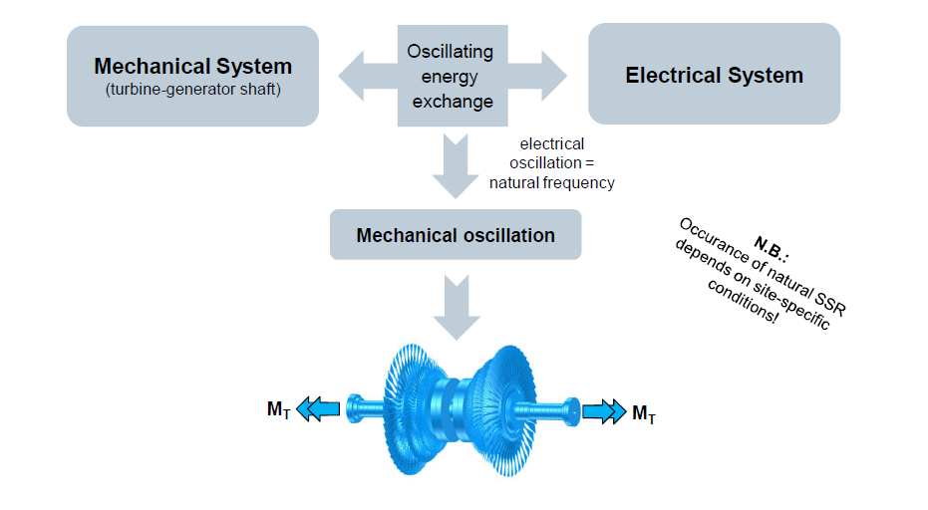
Definition of Sub Synchronous Resonance (SSR)
Energy Exchange between the Mechanical and the Electrical System

Slide 9
Definition of Sub Synchronous Resonance (SSR)
Energy Exchange between the Mechanical and the Electrical System
The „electro-mechanical damping“, dependent on the system parameters, is generally low or even negative. In case of a negative damping there is an increase of the torsional vibrations (instability !), which may lead to impermissibly high stresses and even to damage.
In order to study the Subsynchronous Resonance Phenomena it is absolutely necessary to investigate (simulate) with the greatest possible accuracy, both the entire network with series and parallel capacitances as well as the electrical part of the generator and the mecanical shaft assembly.

Slide 10
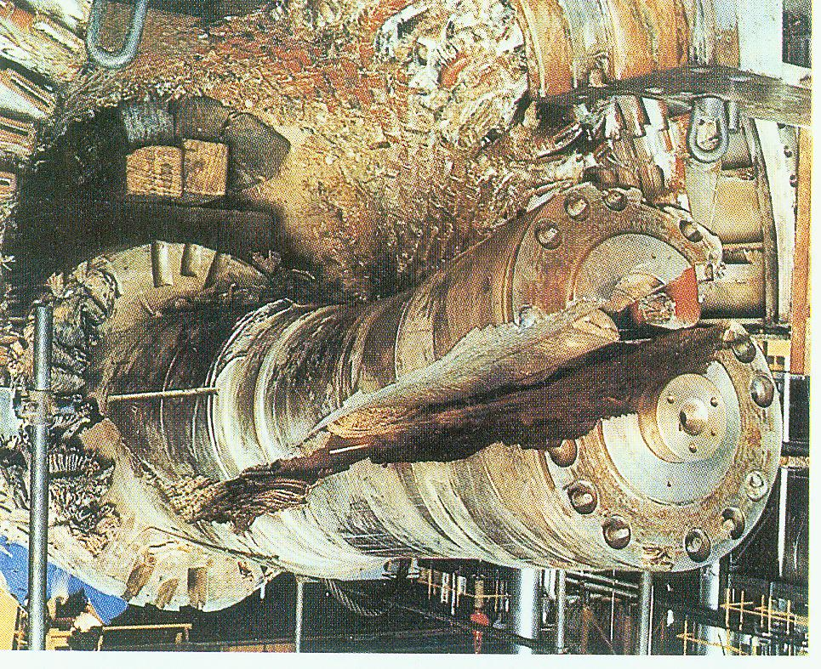
Definition of Sub Synchronous Resonance (SSR)
Damages due to Energy Exchange between Mechanical and Electrical System
Damage of the Generator of a large Turbogenerator System

Slide 11
Definition of Sub Synchronous Resonance (SSR)
Failures due to Energy Exchange between Mechanical and Electrical System
Failures in Couplings of
Turbogenerators

Slide 12
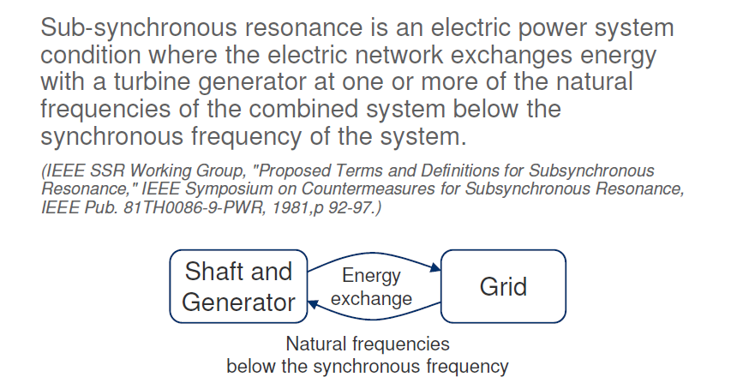
Definition of Sub Synchronous Resonance (SSR)
IEEE Terms and Definition for SSR

Slide 13
Lecture I The Sub Synchronous Resonance Penomenon (SSR)
Definition of Sub Synchronous Resonance (SSR)
Excitation of Vibrations in Turbogenerators due to Air Gap Torques
Conditions for Torsional Vibrations with Sub Synchronous Resonance
A simple Electrical Model with Series Compensation
Electrical Natural Frequencies and Impedance Functions
An SSR- Incident in the OL3 Turbogenerator

Slide 14
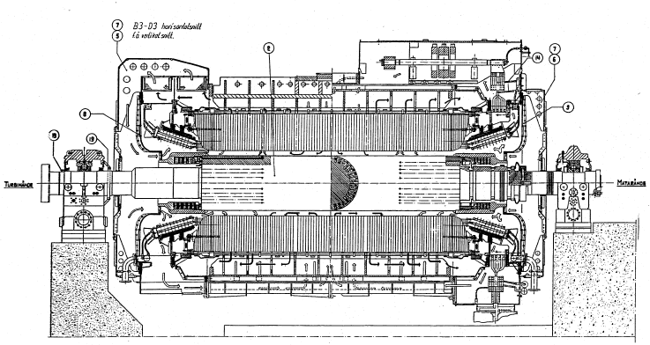

Excitation of Vibrations inTurbogenerators due to Air Gap Torques
Generator Cross Section with Rotor and Stator
Stator
Air Gap Torque Rotor
Excitation of Torsional Vibrations of a Turbogenerator Shaft Train due to an Air Gap Torque, generated by Electro-Mechanical Interaction

Slide 15

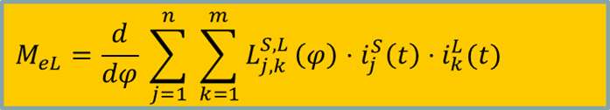



Excitation of Vibrations inTurbogenerators due to Air Gap Torques
Air Gap Torque due to Electromechanical Interaction
Electrical Air Gap Torque:
M_{eL} φ
M_{eL}
Mechanic
Electric
Elektromechanical Interaction in the Air Gap: Rotor & Generator & Grid

Slide 16
Excitation of Vibrations in Turbogenerators due to Air Gap Torques
Air Gap Torque due to Electromechanical Interaction
M_{eL} φ
Due to electrical disturbances or switcing operations in the electrical
generator-grid system transient Air gap torques M_{eL} will be generated, which
excite the shaft train to Torsional vibrations.
The Air gap torques M_{eL} depend on: the electrical quantities:
the currents in the rotor- and stator-windings, the coupling Inductances
and on mechanical quantities.

Slide 17

Excitation of Vibratios in Turbogenerators due to Air Gap Torques
Air Gap Torque due to Electromechanical Interaction
The quantities in the formula for the Air Gap Torque M_{el} depend on several other parameters of the overall system, including the electrical parameters of the Generator and parameters of the Electrical Grid. They influence the currents i_{j}^{S} , i_{k}^{L} and the inductances L_{j,k} and the Air Gap Torque, as well.
E
Electrical
Air Gap Torque
M_{el}
AAir
Turbine
Mechanical

Slide 18
Excitation of Vibrations inTurbogenerators due to Air Gap Torques
Air Gap Torque due to Electromechanical Interaction
A very important question is, which frequencies are in the Air Gap Torque M_{el} and which of these frequencies can excite torsional vibrations of the shaft train of the Turbogenerator?

Slide 19
Lecture I The Sub Synchronous Resonance Penomenon (SSR)
Definition of Sub Synchronous Resonance (SSR)
Excitation of Vibrations in Turbogenerators due to Air Gap Torques
Conditions for Torsional Vibrations with Sub Synchronous Resonance
A simple Electrical Model with Series Compensation
Electrical Natural Frequencies and Impedance Functions
An SSR- Incident in the OL3 Turbogenerator

Slide 20
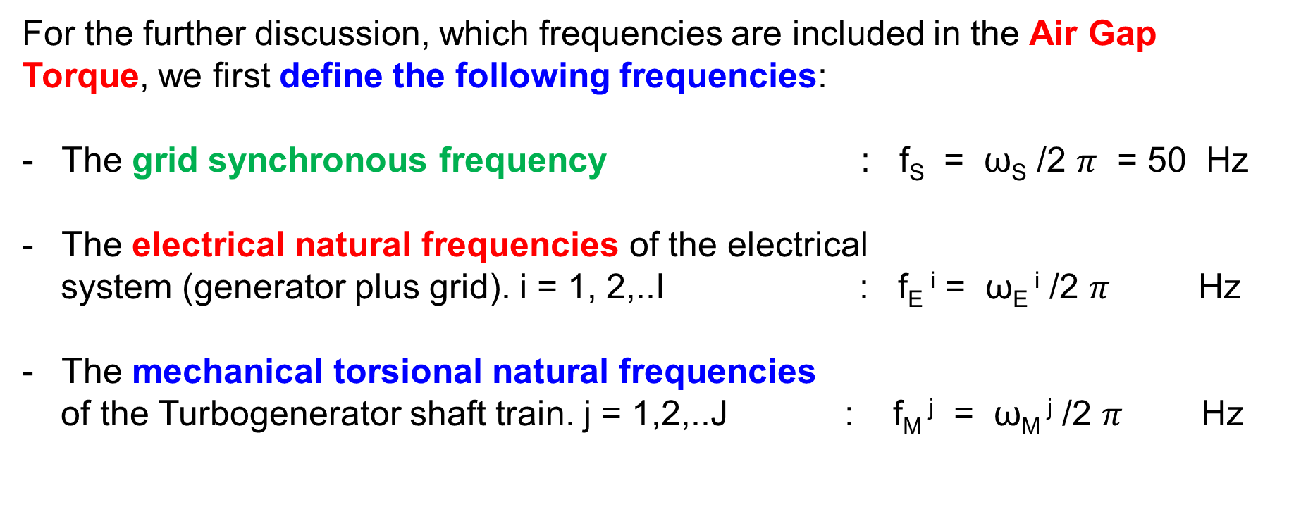
Conditions for Torsional Vibrations with Sub Synchronous Resonance
Frequency content in the Air Gap Torque
For the further discussion, which frequencies are included in the Air Gap Torque, we first define the following frequencies:
The grid synchronous frequency : f_{S} = ω_{S} /2 $π$ = 50 Hz
The electrical natural frequencies of the electrical
system (generator plus grid). i = 1, 2,..I : f_{E} ^{i} = ω_{E} ^{i} /2 $π$ Hz
The mechanical torsional natural frequencies
of the Turbogenerator shaft train. j = 1,2,..J : f_{M} ^{j} = ω_{M} ^{j} /2 $π$ Hz

Slide 21
Conditions for Torsional Vibrations with Sub Synchronous Resonance
Frequency content in the Air Gap Torque
After occurence of a fault in the electrical system oscillating currents with electrical natural frequencies f_{E}^{i} are produced in the power system. Due to these additional electrical resonant currents the Air Gap Torque consists now of the frequencies:
- the rated grid synchronous frequency f_{S} = 50 Hz and
- the electrical grid natural frequencies f_{E}^{i} sub sychronous
In case of one dominant electrical grid natural
frequency f_{E}^{i} the frequency content of the
Air Gap Torque will be equal to the difference f_{AGT} = (f_{S} - f_{E}^{i} )

Slide 22
Conditions for Torsional Vibrations with Sub Synchronous Resonance
Frequency content in the Air Gap Torque
If one of the frequencies (f_{S} - f_{E}^{i} ) is in the vicinity of one of the lowest mechanical torsional natural frequencies f_{M}^{j}, then the shaft assembly will be excited to strong resonant torsional vibrations.
The conditions for Sub Synchronous Resonance are therefore:
f_{M}^{j} Torsional natural frequency of the Shaft
f_{M}^{j} = (f_{S} - f_{E}^{i} ) = f_{AGT} = f_{SSR}^{i}
f_{E}^{i} Electrical natural frequency of the Grid
f_{S} Synchronous frequency of the Grid

Slide 23
Lecture I The Sub Synchronous Resonance Penomenon (SSR)
Definition of Sub Synchronous Resonance (SSR)
Excitation of Vibrations in Turbogenerators due to Air Gap Torques
Conditions for Torsional Vibrations with Sub Synchronous Resonance
A simple Electrical Model with Series Compensation
Electrical Natural Frequencies and Impedance Functions
An SSR- Incident in the OL3 Turbogenerator

Slide 24
A simple Electrical Model with Series Compensation
Motivation to investigate the complement of the electrical natural frequencies
In order to evaluate the SSR-Sensitivity of a Turbogenerator-System with its mechanical and electrical components and the Electrical Grid, the condition for a Sub Synchronous Resonance have to be studied.
As shown before, the probability for an SSR event is high, when one of the shaft natural frequencies f_{M}^{j} is close to the complement of the electrical natural frequencies: (f_{S} - f_{E}^{i} ).
The key for the evaluation of an SSR event is therefore the knowledge of the electrical natural frequencies f_{E}^{i} .The frequencies f_{E}^{i} should include the electrical part of the generator and the grid
In the following presentation we start with a very simple Model of the Electrical Grid plus Generator with Series compensation.

Slide 25
A simple Electrical Model with Series Compensation
Transmission Lines with Series Compensation
Transmission Lines are mainly characterized by series
Inductive Reactance X_{L} = L ω_{S} and by Resistance R
The X_{L} value can limit the maximum allowable transfer, especially across long lines
Additional in series-connected capacitors X_{C} = 1/ (C ꞷ_{S}) reduce the total reactance and increase the maximum transfer across the line.

Slide 26
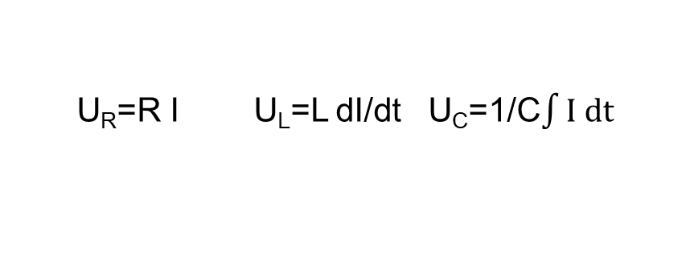
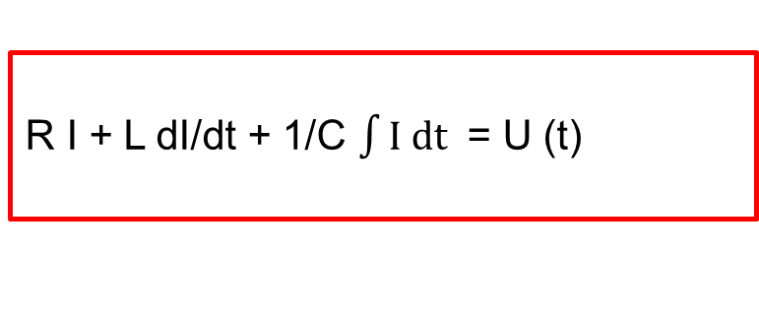


A simple Electrical Model with Series Compensation
Simple Electrical Circuit Model for the Electrical Grid plus Generator
R I(t) L C
Diff. Equation for the Electrical Circuit:
$$⨀$$
R I + L dI/dt + 1/C $\int{I dt }$ = U (t)
U(t)
U_{R}=R I U_{L}=L dI/dt U_{C}=1/C$\int{I dt}$
$$⨀$$
U(t) Voltage, I(t) Current, R Resistance, L Inductance, C Capacity
This very simple Electric Circuit Model shows the basic components of an electric circuit. A real Electrical Model contains much more electrical components of the Grid and in addition also components of the electrical part of the Generator.
However, with this simple model we want to explain in an easy way the basic relations for a Sub Synchronous Resonance (SSR) incident and how the electrical natural frequencies and the Impedance function can be determined and used for an evaluation of SSR.

Slide 27
Lecture I The Sub Synchronous Resonance Penomenon (SSR)
Definition of Sub Synchronous Resonance (SSR)
Excitation of Vibrations in Turbogenerators due to Air Gap Torques
Conditions for Torsional Vibrations with Sub Synchronous Resonance
A simple Electrical Model with Series Compensation
Electrical Natural Frequencies and Impedance Functions
An SSR- Incident in the OL3 Turbogenerator

Slide 28
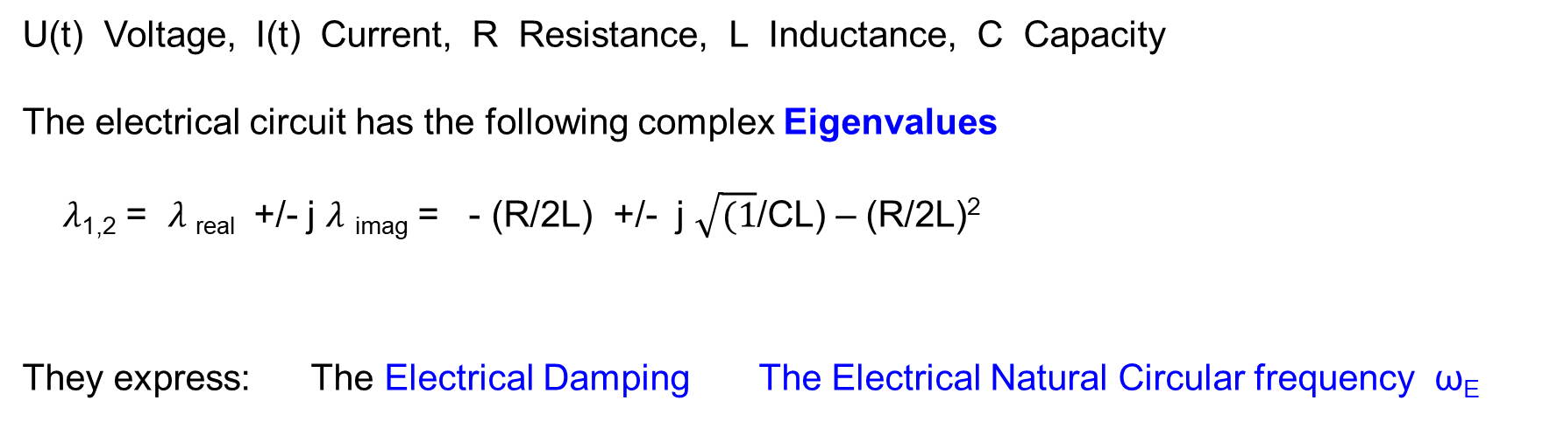
Electrical Natural Frequencies and Impedance Functions
Diff. Equations and Eigenvalues of the Electrical Model with Resistance
R I(t) L C
Diff. Equation for the Electrical Circuit:
$$⨀$$
R I + L dI/dt + 1/C $\int{I dt }$ = U (t)
U(t)
U_{R}=R I U_{L}=L dI/dt U_{C}=1/C$\int{I dt}$
$$⨀$$
U(t) Voltage, I(t) Current, R Resistance, L Inductance, C Capacity
The electrical circuit has the following complex Eigenvalues
$λ$_{1,2} = $λ$ _{real} +/- j $λ$ _{imag} = - (R/2L) +/- j $\sqrt{(1}$/CL) – (R/2L)²
They express: The Electrical Damping The Electrical Natural Circular frequency ꞷ_{E}

Slide 29
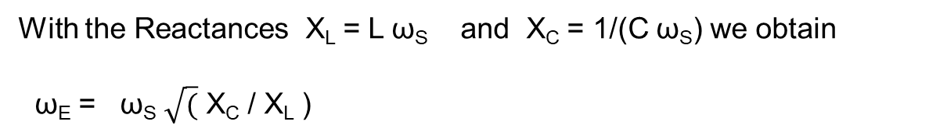
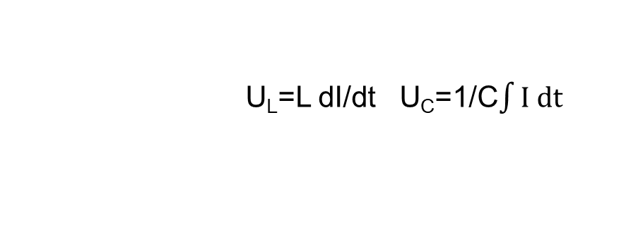
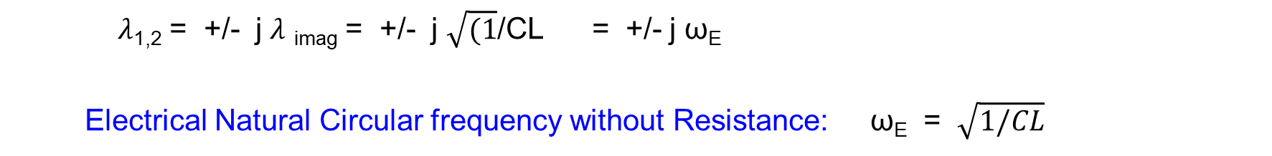
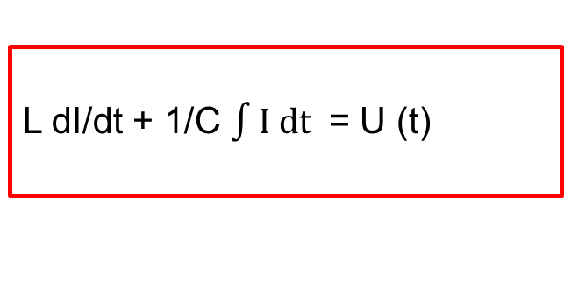


Electrical Natural Frequencies and Impedance Functions
Diff. Equations and Eigenvalues of the Electrical Model without Resistance
I(t) L C
Diff. Equation for the Electrical Circuit:
$$⨀$$
L dI/dt + 1/C $\int{I dt }$ = U (t)
U(t)
U_{L}=L dI/dt U_{C}=1/C$\int{I dt}$
$$⨀$$
$λ$_{1,2} = +/- j $λ$ _{imag} = +/- j $\sqrt{(1}$/CL = +/- j ꞷ_{E}
Electrical Natural Circular frequency without Resistance: ꞷ_{E} = $\sqrt{1/CL}$
With the Reactances X_{L} = L ꞷ_{S} and X_{C} = 1/(C ꞷ_{S}) we obtain
ꞷ_{E} = ꞷ_{S} $\sqrt{(}$ X_{C} / X_{L} )

Slide 30

Electrical Natural Frequencies and Impedance Functions
Natural Electrical Frequency of the Electrical Model without Resistance
Series Compensated Transmission line circuits introduce oscillatory
response to a disturbance, e.g. switching or short circuit.
The natural circular frequency ꞷ_{E} of the circuit without resistance is defined
ꞷ_{E} - electrical natural circular frequency
ꞷ - synchronous frequency of the grid
X_{L} ,X_{C} - inductice and capacitive Reactances
ꞷ_{E} = ꞷ $\sqrt{(1}$ X_{C} / X_{L}

Slide 31
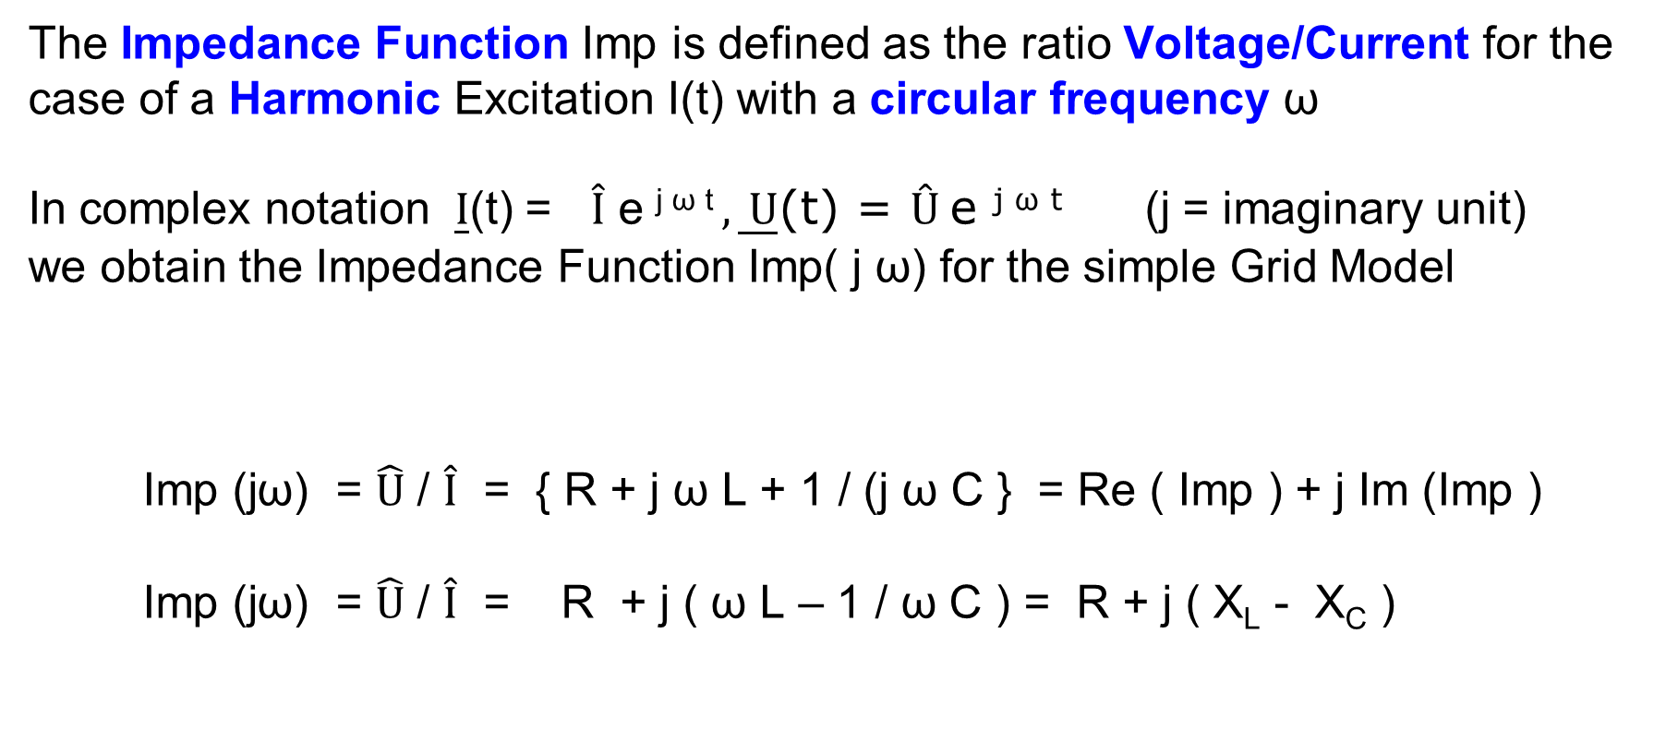
Electrical Natural Frequencies and Impedance Functions
Impedance Function of the simple Electrical Model
The Impedance Function Imp is defined as the ratio Voltage/Current for the
case of a Harmonic Excitation I(t) with a circular frequency ω
In complex notation $\underline{I}$(t) = $\hat{I}$ e ^{j ω t} $, \underline{ U}$(t) = $Û$e ^{j ω t} (j = imaginary unit)
we obtain the Impedance Function Imp( j ω) for the simple Grid Model
Imp (jω) = $\hat{U}$ / $\hat{I}$ = { R + j ω L + 1 / (j ω C } = Re ( Imp ) + j Im (Imp )
Imp (jω) = $\hat{U}$ / $\hat{I}$ = R + j ( ω L – 1 / ω C ) = R + j ( X_{L} - X_{C} )

Slide 32
Electrical Natural Frequencies and Impedance Functions
Impedance Function of the simple Electrical Model
The following information can be obtained from the Impedance Function
Re (Imp (jω)) : R expresses the Resistance (damping) of the simple
electrical circuit. In general if Re (Imp (j ω)) is negative, the
electrical system is unstable!
Im (Imp (jω)) : If (X_{L} - X_{C} ) = 0, then ω² = 1 / ( L C ) = ω_{E}²
Im (J(j ω ) = 0 means, that the electrical circuit is in a
Resonance Condition.
ω_{E} is the Resonance Frequency of the Grid plus Generator

Slide 33
Electrical Natural Frequencies and Impedance Functions
Example of an Impedance Function Imp (j ω )
The investigation of the Impedance Function of the passive Electrical System for the Grid and the electrical part of the Generator is a suited method to predict the possible occurence of an SSR event.
The following diagram shows an example of an Impedance Function in Amplitude and Phase presentation. Three cases of different compensation rates X_{C} are shown in the frequency range from 0 to 60 Hz.
The Electrical Resonance Frequencies for the different compensations can be determined at frequencies, where the Amplitude of the Impedance Function is Zero (26 Hz, 35 Hz and 42 Hz). If in this 60Hz (synchr. frequency) application the Mechanical Natural Frequencies are at for example 18 Hz and 34 Hz, the conditions of an SSR event are most likely.

Slide 34
Electrical Natural Frequencies and Impedance Functions
Amplitude and Phase of an Impedance Function for different compensations

Slide 35
Lecture I The Sub Synchronous Resonance Penomenon (SSR)
Definition of Sub Synchronous Resonance (SSR)
Excitation of Vibrations in Turbogenerators due to Air Gap Torques
Conditions for Torsional Vibrations with Sub Synchronous Resonance
A simple Electrical Model with Series Compensation
Electrical Natural Frequencies and Impedance Functions
An SSR- Incident in the OL3 Turbogenerator

Slide 36
An SSR-Incident in the OL3 Turbogenerator
Example of Impedance Functions of the Finish Grid close to OL3
The following diagram shows calculated frequency-dependent amplitudes of four Impedance Functions for different topologies of the Finish Grid close to the OL3 Turbogenerator System. These passive Impedance scans show the network plus the integrated Generator as seen from the Generator terminals.
The solid red curve presents the Impedance Function of one topology, for which an SSR event occured in reality at the OL3 Turbogenerator. The calculated Impedance Function did not reach a value of zero, however a minimum has been predicted at a frequency of 34,5 Hz.
If the frequency at this Minimum can be interpreted as one of the electrical natural frequencies f_{E}^{i} = 34,5 Hz of the Grid plus Generator, an occurence of SSR can be expected at the frequency of (f_{S} - f_{E}^{i} ) = 15.5 Hz. This value fits quite well to one the torsional natural frequency of 14,4 Hz.

Slide 37
An SSR-Incident in the OL3 Turbogenerator
Impedance Function of the Finish Grid plus Generator close to OL3
Impedance
Imp (Ohm)
Minimum at 34,5 Hz
Mech. Natural Frequency14,4 Hz
Hz

Slide 38
An SSR-Incident in the OL3 Turbogenerator
Lowest Torsional Natural Frequencies and Mode Shapes of OL3
The four lowest Torsional Natural Frequencies f_{M}^{j} = ω_{M}^{j} /2 $π$Hz of the OL3 Turbogenerator Shaft Train are presented in the next diagram together with the corresponding Mode Shapes φ_{M}^{j} . They are in the range between 5,9 Hz to 24,0 Hz and are relevant for a Sub Synchronous Resonance (SSR) event.
The first three Modes can be well excited by an Air Gap Torque, due to the fact, that these Modes have dominant angular displacements in the Generator part. This is particularly the case for the 3rd mode at 14,6 Hz. Therefore this frequency is very sensitive regarding SSR.
The Blade-Rotor-Coupling is not relevant for these lower Modes and can be neglected. The blades are only considered by their moments of inertia.

Slide 39
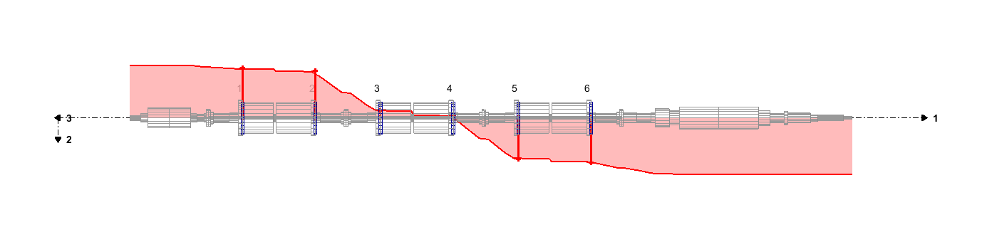
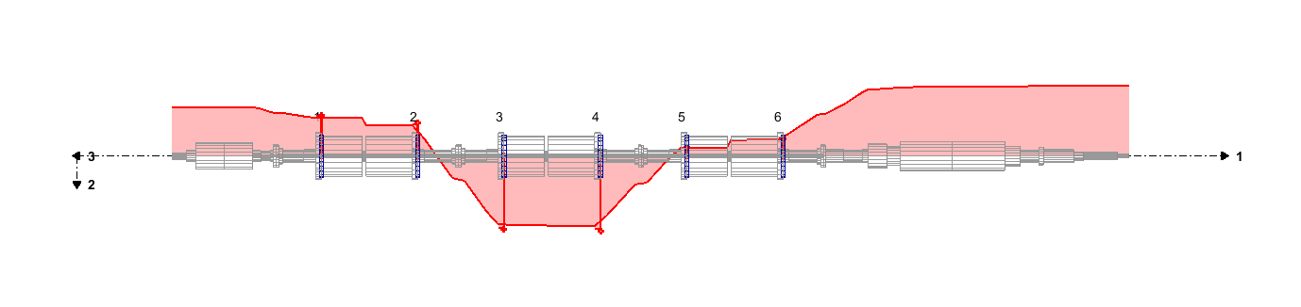
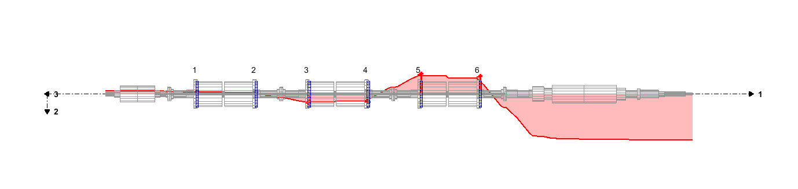
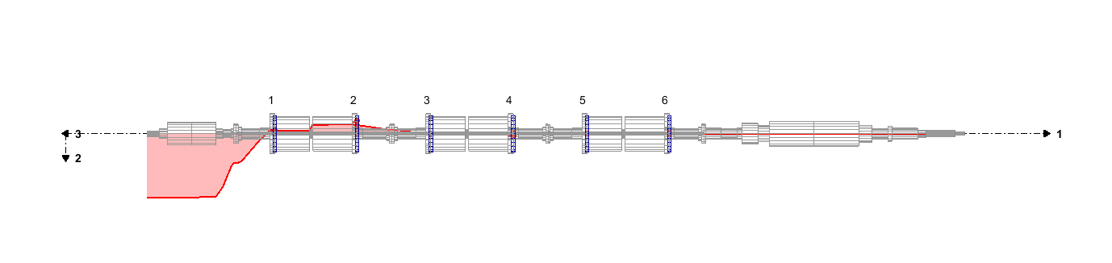
An SSR-Incident in the OL3 Turbogenerator
Lowest Torsional Natural Frequencies and Modes of OL3-Turbogenrator
5.9 Hz
10.9 Hz
14.6 Hz
24.0 Hz
Torsional Natural Frequencies: f_{M}^{j} = ω_{M}^{j} / 2 $π$ Hz (j = 1, 2…4)
Mode Shapes of the Shaft Train: φ_{M}^{j}

Slide 40
An SSR-Incident in the OL3 Turbogenerator
Frequency content in the Air Gap Torque
If one of the frequencies (f_{S} - f_{E}^{i} ) is in the vicinity of one of the lowest mechanical torsional natural frequencies f_{M}^{j}, then the shaft assembly will be excited to strong resonant torsional vibrations.
The conditions for Sub Synchronous Resonance are therefore:
f_{M}^{j} Torsional natural frequency of the Shaft
f_{M}^{j} = (f_{S} - f_{E}^{i} ) = f_{AGT} = f_{SSR}^{i}
f_{E}^{i} Electrical natural frequency of the Grid
f_{S} Synchronous frequency of the Grid

Slide 41
An SSR-Incident in the OL3 Turbogenerator
Sensors to Measure Torsional Vibrations in the OL3 Turbogenerator
Strain gauge Sensors and SSR Sesors to measure Time signals of stresses
The measured stresses at 14,4 Hz show the SSR- Incident in the Generator

Slide 42
An SSR–Incident in the OL3 Turbogenerator
Monitoring of the SSR incidents on 5.1.23 by SSR sensors at loc. 3, 5, 8
Maximum stress at loc.8: 145 MPa
M
Loc.8
Loc.5
Loc.3

Slide 43
An SSR – Incident in the OL3 Turbogenerator
Monitoring of the OL3-SSR event 1 on 5.1.23 by SSR1 sensor at loc.8
stress
stress
time
14,4 Hz
14,4 Hz
time
frequency
frequency

Slide 44
Energiforsk Project: Lectures in the Power Plants
Ringhals, Oskarshamn and Forsmark, March 2024
Annual Energiforsk Seminar (10.11.21)
Vorlesungen Mechatronik im Wintersemester
Vibrations of Turbines and Generators in Power Plants
Lecture II The Subsynchronous Resonance Phenomenon (SSR)
Rainer Nordmann
Technische Universität Darmstadt

