Slide 1
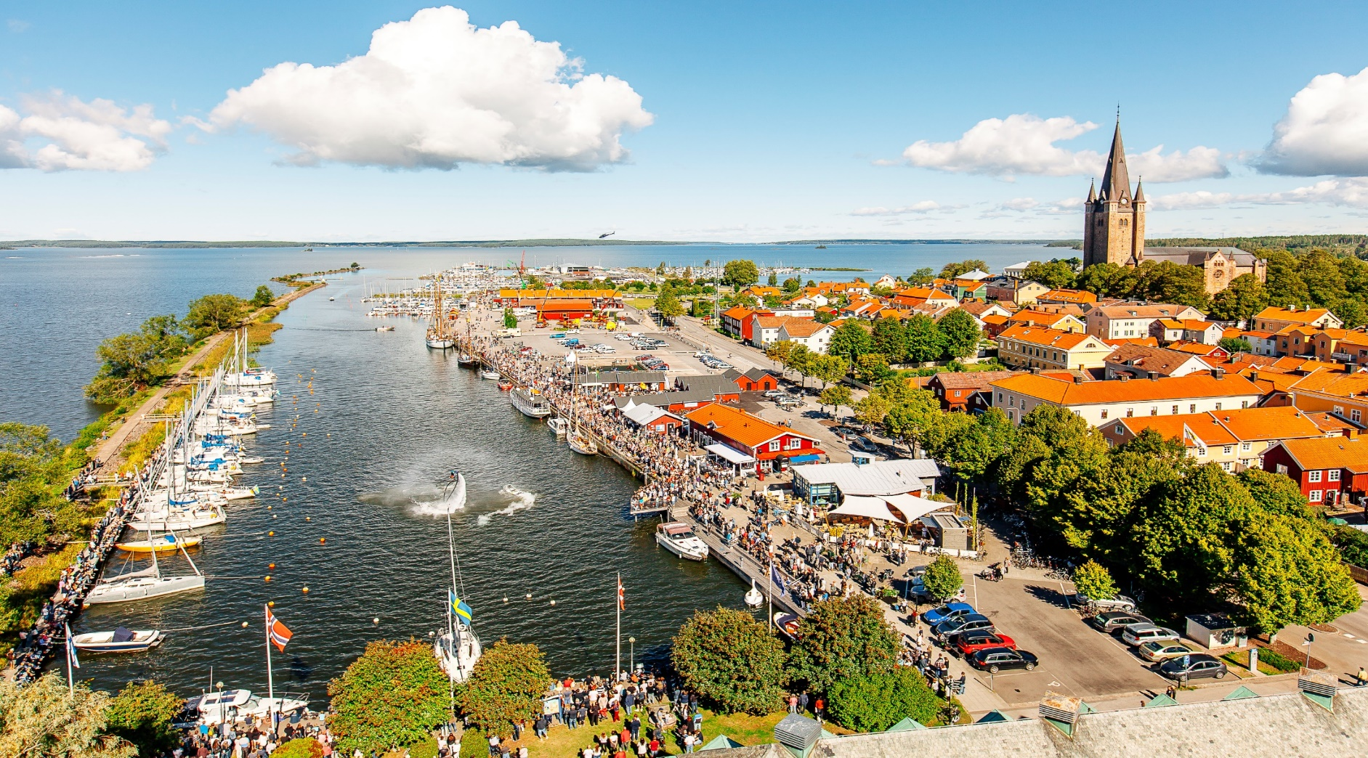
The Mariestad story

Slide 2
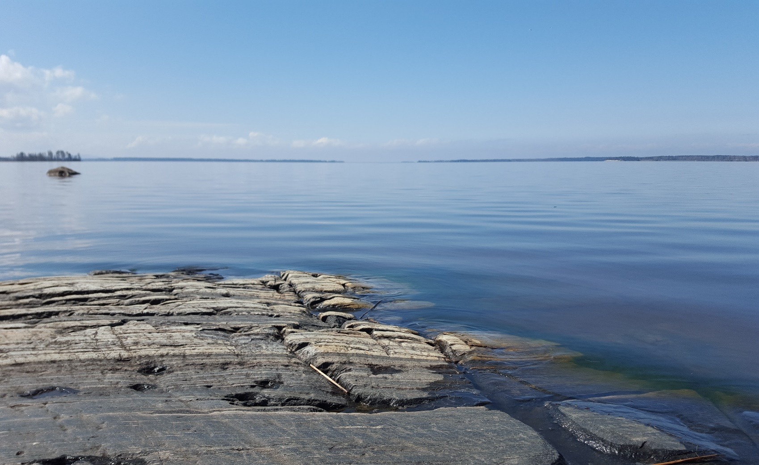
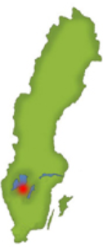
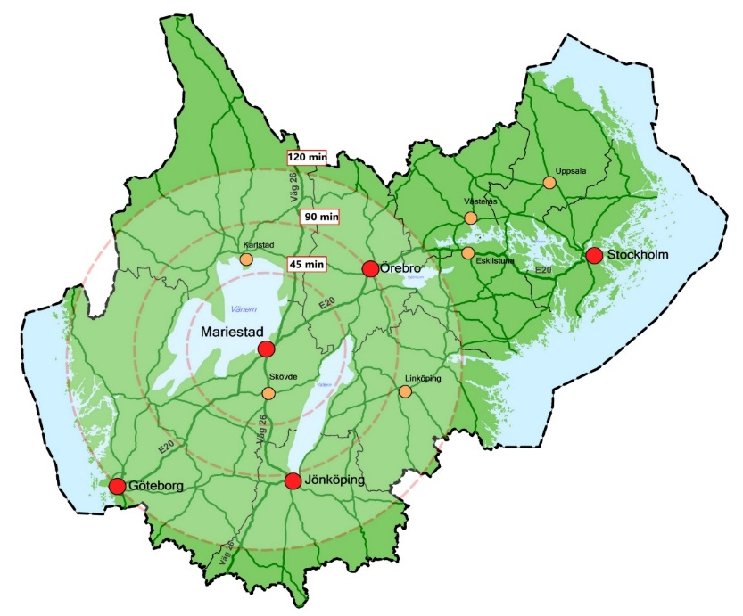
Mariestad
Sweden
24 400 inhabitants
Central position in a region with 270 000 inhabitants
Long tradition in manufacturing Industry. Old industry moving out.
Touristic spot
Local University platform

Slide 3
Model area of Sustainability
designated by the Unesco
Actions to live up to climate goals, Agenda 2030
New business opportunities
New professions
New tourism
Our ambitions:

Slide 4
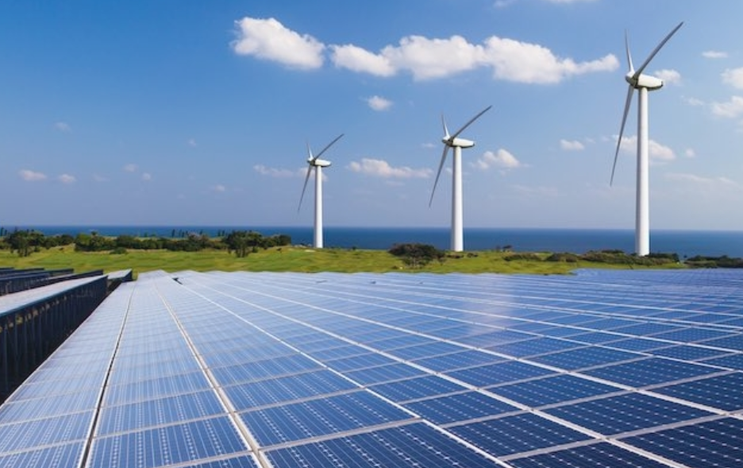
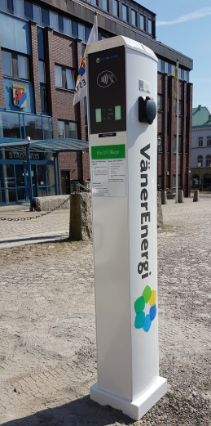
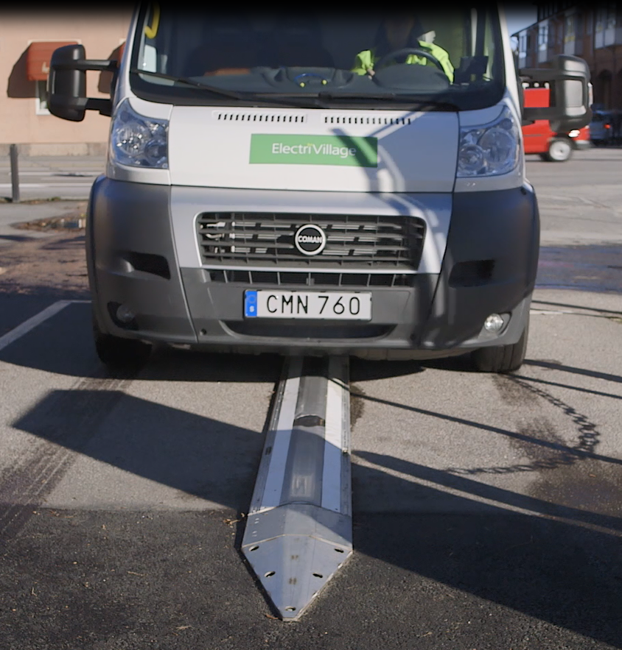
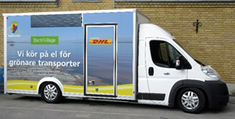
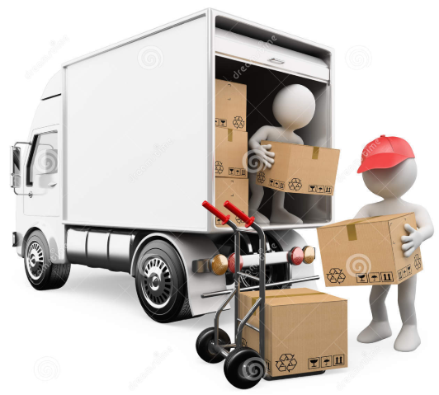
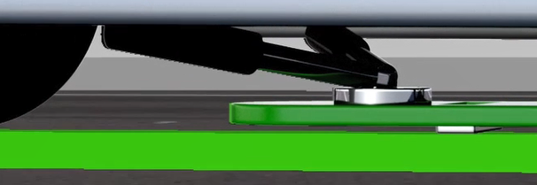
The concept ElectriVillage
and ongoing project
Renewable energy
New Science and education
New business
opportunities
/ new jobs
Innovative procurement
Test & Demonstration
Charging posts
Road bound charging
Logistic -hub
Electric vehicles
Sustainable society
Distributes goods to our schools

Slide 5
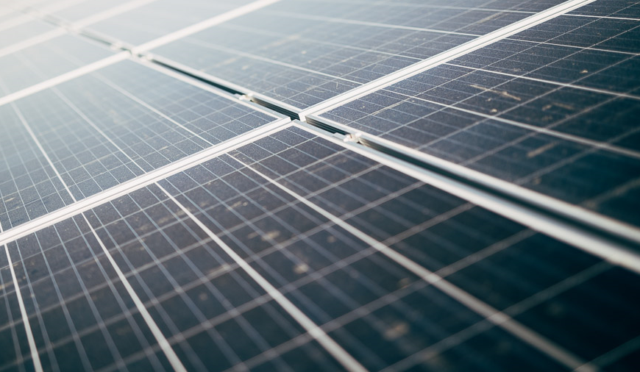
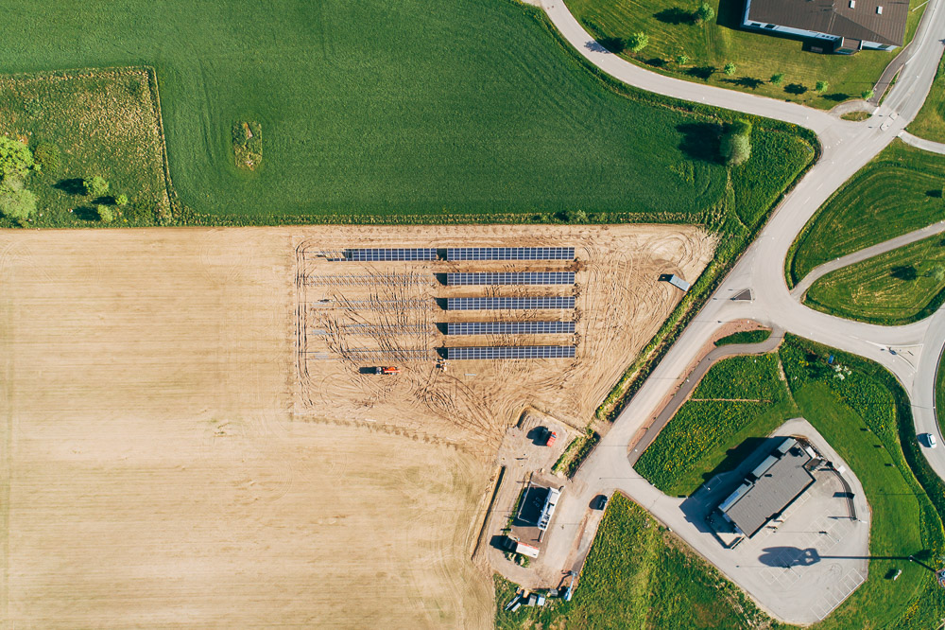
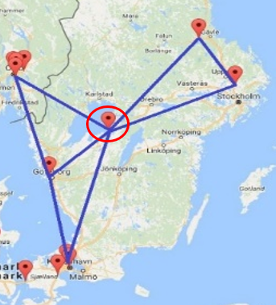
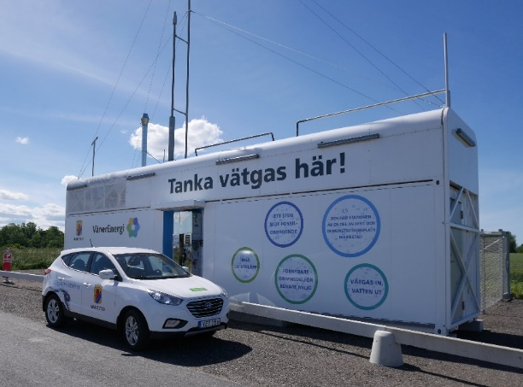
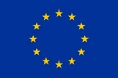
H2E Energisystem
The first solarcell driven hydrogen refuelling station in the world connected to solarcells

Slide 6
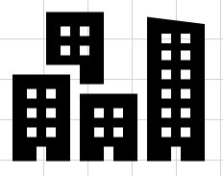
Storage system for the energy
acid for the environment
Heat
65°C
H2
O2
Acid from the environmnet
Hydrogen
Charing of the battery
Powercell
H2O
Water in return
Hydrogen tank
Elektrolyser
Charger for the cars with powercells
Source for this skiss: Nilsson Energy AB

Slide 7
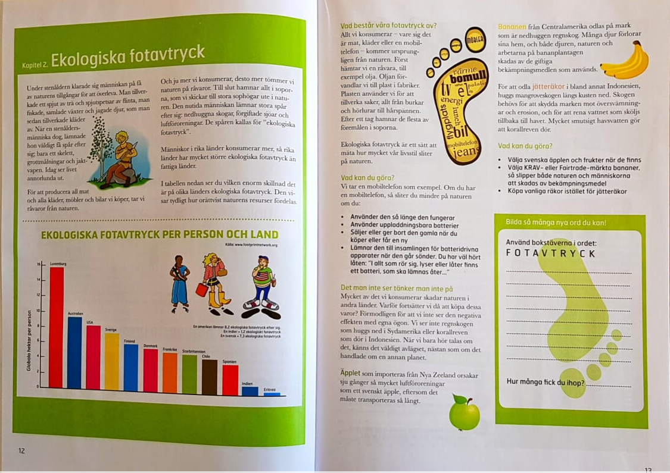
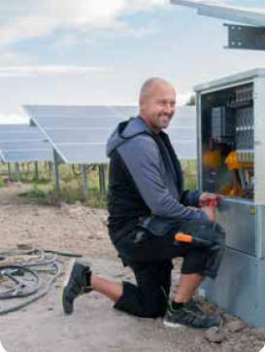
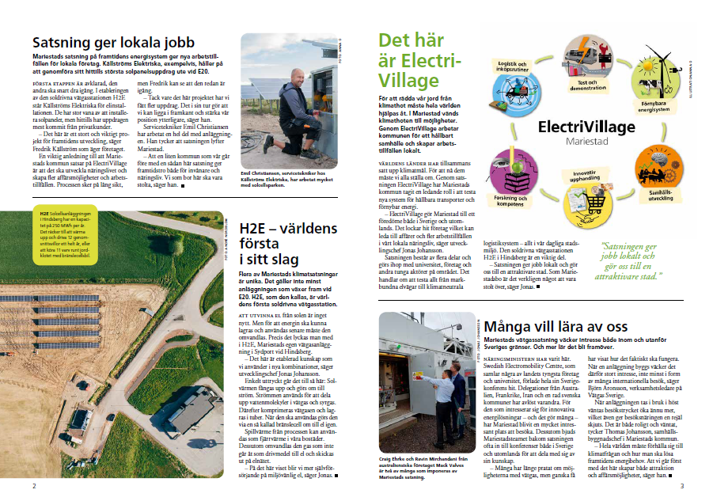
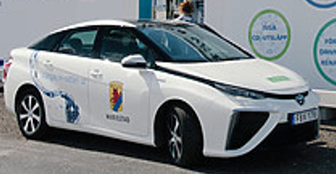
How to involve inhabitants and companies
Educational material, gives our children in schools knowledge how to act to a better sustainable world
Our movie about
School & ElectriVillage
Information to all households about our projects
We use local companies in our projects
Our home care personnel use our FC-cars

Slide 8
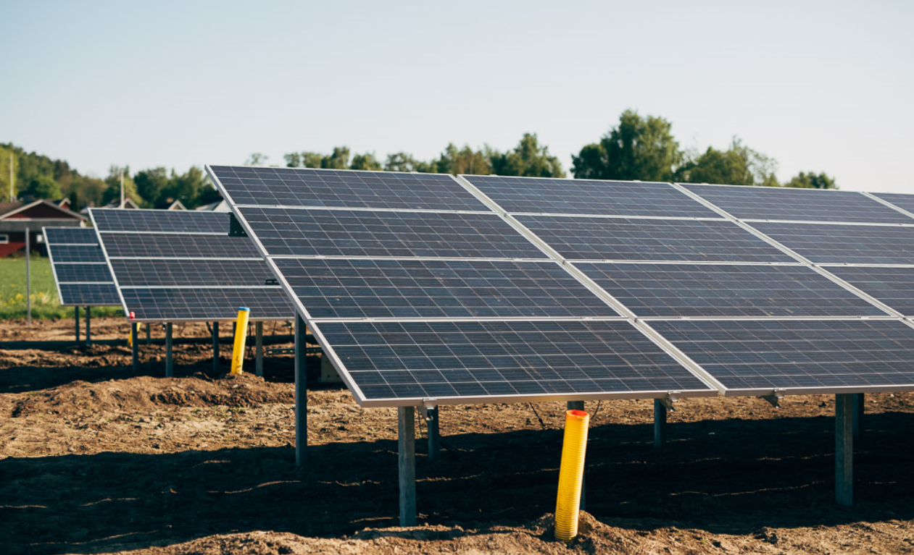
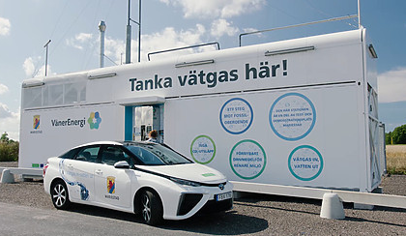
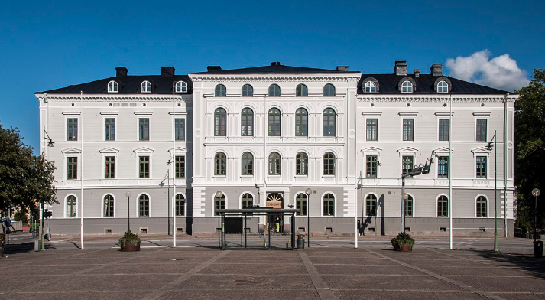
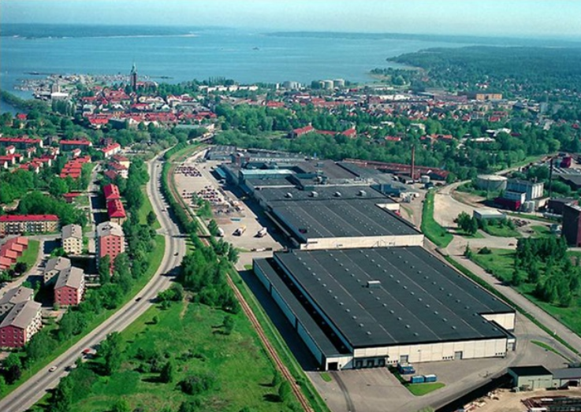
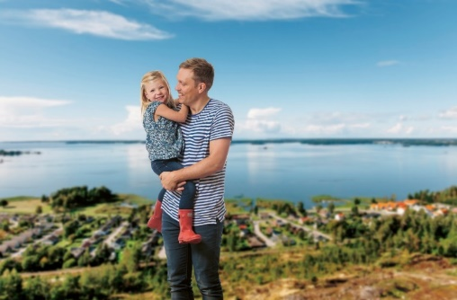
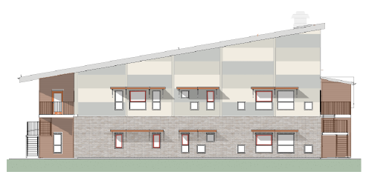
Investments for a sustainable society
Construction
Hydrogen Car pool
Education
Sun, Hydrogen
Electricity
Tourism
Industry, services
meets new business
Housing
program
Preschools
Off grid

Slide 9
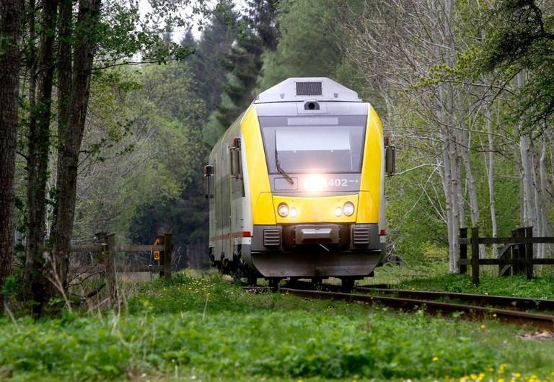
Future projects
Kinnekullebanan Sweden most beautiful railway
Today diesel and a lot of effluent

Slide 10
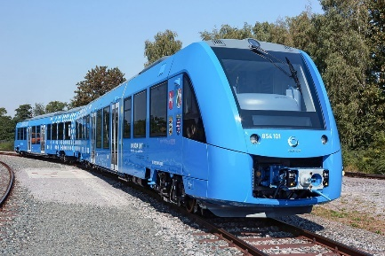
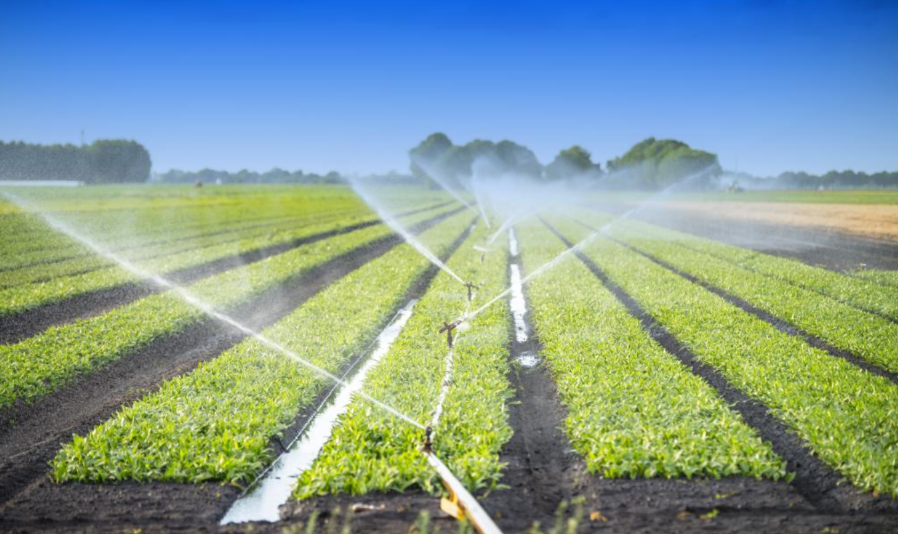
Future project
Train
Agriculture
Hydrogen, fuel cell driven
Production from renewable sources

Slide 11
Experiences / lessons learnt
Visions & Science
Holistic approach
System thinking
Courage
Leadership
Determination

